Slide 1

2023届深圳二模
读 后 续 写
芭蕾女孩转打拳击

Slide 2
01
原文分析
contents
02
表达积累
03
续写扩展
04
续写赏析

Slide 3
Ballet was a way of life in Kelly's family. Her elder sister Serena was now dancing at a top college. Though Kelly's mom always wanted her to follow in her sister's footsteps and Kelly herself was good at ballet, her love for ballet had faded years before, and she was eager for a new challenge.
One day at school, as Kelly left the dance studio, she walked past the gym, fascinated by boxers(拳击手)training inside the boxing ring.She was deeply impressed by how hard they hit and how fast they moved. In fact, she'd long been attracted to boxing.
She pulled a piece of paper from her backpack. On the familiar Oakwood High School Club Sign-up Sheet was the phrase: BOXING CLUB TRYOUT(选拔). That was what Kelly really wanted to do. She knew her mom had high expectations for her when it came to ballet. Tired of trying to keep up with her sister, Kelly was ready to carve her own path.
The next day, she gathered her courage and told Serena about her new passion. At first, Serena didn't understand and thought she was just joking. But when she saw Kelly was serious, she replied,“You know Mom wants you to be a ballet dancer, right? Besides, boxing is only for boys, and you're so good at ballet. Lean into your strength, Kelly.”
“But this is where I want to put my strength,”Kelly insisted,“and what exactly does 'only for boys' mean, anyway? Boxing is a sport for everyone!”
Gradually, touched by her determination and passion, Serena began to understand and support her. Kelly could feel it. Her sister was going to respect her decision, no matter what. But that was nothing compared to the preparations for the tryout, where she was required to show her footwork and punching (击打)abilities with other candidates. Boxing didn't come natural to Kelly, but she had made up her mind to stick with her choice.
Para 1： Then Kelly began her training for the tryout, keeping it a secret from her mom.
Para2: The following Monday,results of the boxing tryout were posted.
Notes:
更多模板亮亮图文旗舰店：https://liangliangtuwen.tmall.com

Slide 4

01
原文分析

Slide 5
Ballet was a way of life in Kelly's family. Her elder sister Serena was now dancing at a top college. Though Kelly's mom always wanted her to follow in her sister's footsteps and Kelly herself was good at ballet, her love for ballet had faded years before, and she was eager for a new challenge.
One day at school, as Kelly left the dance studio, she walked past the gym, fascinated by boxers(拳击手)training inside the boxing ring.She was deeply impressed by how hard they hit and how fast they moved. In fact, she'd long been attracted to boxing.
She pulled a piece of paper from her backpack. On the familiar Oakwood High School Club Sign-up Sheet was the phrase: BOXING CLUB TRYOUT(选拔). That was what Kelly really wanted to do. She knew her mom had high expectations for her when it came to ballet. Tired of trying to keep up with her sister, Kelly was ready to carve her own path.
The next day, she gathered her courage and told Serena about her new passion. At first, Serena didn't understand and thought she was just joking. But when she saw Kelly was serious, she replied,“You know Mom wants you to be a ballet dancer, right? Besides, boxing is only for boys, and you're so good at ballet. Lean into your strength, Kelly.”
“But this is where I want to put my strength,”Kelly insisted,“and what exactly does 'only for boys' mean, anyway? Boxing is a sport for everyone!”
Gradually, touched by her determination and passion, Serena began to understand and support her. Kelly could feel it. Her sister was going to respect her decision, no matter what. But that was nothing compared to the preparations for the tryout, where she was required to show her footwork and punching (击打)abilities with other candidates. Boxing didn't come natural to Kelly, but she had made up her mind to stick with her choice
Para 1： Then Kelly began her training for the tryout, keeping it a secret from her mom.
Para2: The following Monday,results of the boxing tryout were posted.
如何快速梳理故事情节线与情感线？
Tip 1:找时间线索，
时间的变化带
来情节的发展
Tip 2:找地点线索，
地点的变化带
来情节的发展
Tip 3:
分析人物对话，
通过人物对话 来推进情节发展
Tip 4:找逻辑关系，通过逻辑关系来带动情节发展。
Notes:
更多模板亮亮图文旗舰店：https://liangliangtuwen.tmall.com

Slide 6
Ballet was a way of life in Kelly's family. Her elder sister Serena was now dancing at a top college. Though Kelly's mom always wanted her to follow in her sister's footsteps and Kelly herself was good at ballet, her love for ballet had faded years before, and she was eager for a new challenge.
One day at school, as Kelly left the dance studio, she walked past the gym, fascinated by boxers(拳击手)training inside the boxing ring.She was deeply impressed by how hard they hit and how fast they moved. In fact, she'd long been attracted to boxing.
She pulled a piece of paper from her backpack. On the familiar Oakwood High School Club Sign-up Sheet was the phrase: BOXING CLUB TRYOUT(选拔). That was what Kelly really wanted to do. She knew her mom had high expectations for her when it came to ballet. Tired of trying to keep up with her sister, Kelly was ready to carve her own path.
The next day, she gathered her courage and told Serena about her new passion. At first, Serena didn't understand and thought she was just joking. But when she saw Kelly was serious, she replied,“You know Mom wants you to be a ballet dancer, right? Besides, boxing is only for boys, and you're so good at ballet. Lean into your strength, Kelly.”
“But this is where I want to put my strength,”Kelly insisted,“and what exactly does 'only for boys' mean, anyway? Boxing is a sport for everyone!”
Gradually, touched by her determination and passion, Serena began to understand and support her. Kelly could feel it. Her sister was going to respect her decision, no matter what. But that was nothing compared to the preparations for the tryout, where she was required to show her footwork and punching (击打)abilities with other candidates. Boxing didn't come natural to Kelly, but she had made up her mind to stick with her choice.
Para 1： Then Kelly began her training for the tryout, keeping it a secret from her mom.
Para2: The following Monday,results of the boxing tryout were posted.
.
Kelly's family wanted her to work on Ballet but she was eager for a new challenge---boxing.
Read for plots
feel tortured
Kelly told her sister her new passion and eventually gained her sister’s support.
happy, determined
. Boxing didn't come natural to Kelly, but she had made up her mind to stick with her choice.
Notes:
更多模板亮亮图文旗舰店：https://liangliangtuwen.tmall.com

Slide 7

Analyze the Plot and Emotion
. Boxing didn't come natural to Kelly, but she had made up her mind to stick with her choice.
Climax
Para 1： Then Kelly began her training for the tryout, keeping it a secret from her mom
Rising action
Falling action
Kelly told her sister her new passion and eventually gained her sister’s support.
Para2: The following Monday,results of the boxing tryout were posted.
Background
Ending
Kelly's family wanted her to work on Ballet but she was eager for a new challenge---boxing.
???

Slide 8
Read for Characters
Ballet was a way of life in Kelly's family. Her elder sister Serena was now dancing at a top college. Though Kelly's mom always wanted her to follow in her sister's footsteps and Kelly herself was good at ballet, her love for ballet had faded years before, and she was eager for a new challenge.
One day at school, as Kelly left the dance studio, she walked past the gym, fascinated by boxers(拳击手)training inside the boxing ring. She was deeply impressed by how hard they hit and how fast they moved. In fact, she'd long been attracted to boxing.
She pulled a piece of paper from her backpack. On the familiar Oakwood High School Club Sign-up Sheet was the phrase: BOXING CLUB TRYOUT(选拔). That was what Kelly really wanted to do. She knew her mom had high expectations for her when it came to ballet. Tired of trying to keep up with her sister, Kelly was ready to carve her own path.
The next day, she gathered her courage and told Serena about her new passion. At first, Serena didn't understand and thought she was just joking. But when she saw Kelly was serious, she replied,“You know Mom wants you to be a ballet dancer, right? Besides, boxing is only for boys, and you're so good at ballet. Lean into your strength, Kelly.”
“But this is where I want to put my strength,”Kelly insisted,“and what exactly does 'only for boys' mean, anyway? Boxing is a sport for everyone!”
Gradually, touched by her determination and passion, Serena began to understand and support her. Kelly could feel it. Her sister was going to respect her decision, no matter what. But that was nothing compared to the preparations for the tryout, where she was required to show her footwork and punching (击打)abilities with other candidates. Boxing didn't come natural to Kelly, but she had made up her mind to stick with her choice.
Para 1： Then Kelly began her training for the tryout, keeping it a secret from her mom.
Para2: The following Monday,results of the boxing tryout were posted..
Kelly:
eager to try new things, determined,
independent-minded
Serena:
excellent,
considerate,
supportive
Notes:
更多模板亮亮图文旗舰店：https://liangliangtuwen.tmall.com

Slide 9
Read for conflicts
Ballet was a way of life in Kelly's family. Her elder sister Serena was now dancing at a top college. Though Kelly's mom always wanted her to follow in her sister's footsteps and Kelly herself was good at ballet, her love for ballet had faded years before, and she was eager for a new challenge.
One day at school, as Kelly left the dance studio, she walked past the gym, fascinated by boxers(拳击手)training inside the boxing ring.She was deeply impressed by how hard they hit and how fast they moved. In fact, she'd long been attracted to boxing.
She pulled a piece of paper from her backpack. On the familiar Oakwood High School Club Sign-up Sheet was the phrase: BOXING CLUB TRYOUT(选拔). That was what Kelly really wanted to do. She knew her mom had high expectations for her when it came to ballet. Tired of trying to keep up with her sister, Kelly was ready to carve her own path.
The next day, she gathered her courage and told Serena about her new passion. At first, Serena didn't understand and thought she was just joking. But when she saw Kelly was serious, she replied,“You know Mom wants you to be a ballet dancer, right? Besides, boxing is only for boys, and you're so good at ballet. Lean into your strength, Kelly.”
“But this is where I want to put my strength,”Kelly insisted,“and what exactly does 'only for boys' mean, anyway? Boxing is a sport for everyone!”
Gradually, touched by her determination and passion, Serena began to understand and support her. Kelly could feel it. Her sister was going to respect her decision, no matter what. But that was nothing compared to the preparations for the tryout, where she was required to show her footwork and punching (击打)abilities with other candidates. Boxing didn't come natural to Kelly, but she had made up her mind to stick with her choice.
Para 1： Then Kelly began her training for the tryout, keeping it a secret from her mom.
Para2: The following Monday, results of the boxing tryout were posted..
1.Ballet was a way of life in Kelly's family, but Kelly was eager to try a new challenge—boxing.
2.Kelly told Serena about her new passion, and eventually got her support.
3.Boxing was very
demanding, but Kelly
would not give up easily.
4.She kept it a secret from her mom.
Notes:
更多模板亮亮图文旗舰店：https://liangliangtuwen.tmall.com

Slide 10
Read for foreshadowing伏笔
Ballet was a way of life in Kelly's family. Her elder sister Serena was now dancing at a top college. Though Kelly's mom always wanted her to follow in her sister's footsteps and Kelly herself was good at ballet, her love for ballet had faded years before, and she was eager for a new challenge.
One day at school, as Kelly left the dance studio, she walked past the gym, fascinated by boxers(拳击手)training inside the boxing ring. She was deeply impressed by how hard they hit and how fast they moved. In fact, she'd long been attracted to boxing.
She pulled a piece of paper from her backpack. On the familiar Oakwood High School Club Sign-up Sheet was the phrase: BOXING CLUB TRYOUT(选拔). That was what Kelly really wanted to do. She knew her mom had high expectations for her when it came to ballet. Tired of trying to keep up with her sister, Kelly was ready to carve her own path.
The next day, she gathered her courage and told Serena about her new passion. At first, Serena didn't understand and thought she was just joking. But when she saw Kelly was serious, she replied,“You know Mom wants you to be a ballet dancer, right? Besides, boxing is only for boys, and you're so good at ballet. Lean into your strength, Kelly.”
“But this is where I want to put my strength,”Kelly insisted,“and what exactly does 'only for boys' mean, anyway? Boxing is a sport for everyone!”
Gradually, touched by her determination and passion, Serena began to understand and support her. Kelly could feel it. Her sister was going to respect her decision, no matter what. But that was nothing compared to the preparations for the tryout, where she was required to show her footwork and punching (击打)abilities with other candidates. Boxing didn't come natural to Kelly, but she had made up her mind to stick with her choice.
Para 1： Then Kelly began her training for the tryout, keeping it a secret from her mom.
Para2: The following Monday, results of the boxing tryout were posted..
The details about boxing and its tryout?
Notes:
更多模板亮亮图文旗舰店：https://liangliangtuwen.tmall.com

Slide 11

原文分析
Themes
原文分析
故事概要：Kelly 一家以跳芭蕾为传统，她的妈妈也想让她追随姐姐Serena 的脚步继续跳芭蕾，但Kelly 另有打算，钟爱拳击。
故事的主题：
勇敢突破，敢于追求自己的梦想。

Slide 12
Analyze language
Ballet was a way of life in Kelly's family. Her elder sister Serena was now dancing at a top college. Though Kelly's mom always wanted her to follow in her sister's footsteps and Kelly herself was good at ballet, her love for ballet had faded years before, and she was eager for a new challenge.
One day at school, as Kelly left the dance studio, she walked past the gym, fascinated by boxers(拳击手)training inside the boxing ring.She was deeply impressed by how hard they hit and how fast they moved. In fact, she'd long been attracted to boxing.
She pulled a piece of paper from her backpack. On the familiar Oakwood High School Club Sign-up Sheet was the phrase: BOXING CLUB TRYOUT(选拔). That was what Kelly really wanted to do. She knew her mom had high expectations for her when it came to ballet. Tired of trying to keep up with her sister, Kelly was ready to carve her own path.
The next day, she gathered her courage and told Serena about her new passion. At first, Serena didn't understand and thought she was just joking. But when she saw Kelly was serious, she replied,“You know Mom wants you to be a ballet dancer, right? Besides, boxing is only for boys, and you're so good at ballet. Lean into your strength, Kelly.”
“But this is where I want to put my strength,”Kelly insisted,“and what exactly does 'only for boys' mean, anyway? Boxing is a sport for everyone!”
Gradually, touched by her determination and passion, Serena began to understand and support her. Kelly could feel it. Her sister was going to respect her decision, no matter what. But that was nothing compared to the preparations for the tryout, where she was required to show her footwork and punching (击打)abilities with other candidates. Boxing didn't come natural to Kelly, but she had made up her mind to stick with her choice.
Para 1： Then Kelly began her training for the tryout, keeping it a secret from her mom.
Para2: The following Monday, results of the boxing tryout were posted.
部分心理描写
部分对话描写
根据语篇协同性原则：
续写部分应该有适量的对话描写与合理的心理描写
Notes:
更多模板亮亮图文旗舰店：https://liangliangtuwen.tmall.com

Slide 13
03
续写扩展

Slide 14
Analyse the given sentences
What can you infer from the two sentences?
P1:Then Kelly began her training for the tryout, keeping it a secret from her mom.
Para2: The following Monday, results of the boxing tryout were posted..
1.what did Kelly do to train for the tryout? Did she encounter any difficulty?
2.How did she keep it a secret from her mom? Did she succeed keeping the secret?
3.Kelly took part in the tryout
What was the result?
What did she learn from the experience? (THEME)

Slide 15
Paragraph 1
P1:Then Kelly began her training for the tryout, keeping it a secret from her mom.
She trained hard everyday ,practicing footwork and punching
abilities.
She spent extra time away from home.
she succeeded keeping the secret and participated in the tryout./
Her mother found out the secret and objected her choice but eventually supported her just like her sister.

Slide 16
Paragraph 2
P2: The following Monday, results of the boxing tryout were posted
Kelly did well in the tryout./She failed the tryout.
If she successfully kept the secret in paragraph one, she could
tell her mother the truth and got her mother’s support.
She realized that everyone should pursuit their dream bravely.

Slide 17
03
表达积累

Slide 18
微场景写作之努力
回国后，梅西开始下定决心，在决赛前成为一名真正的球员。因此，无论刮风下雨，他都不遗余力地练习踢球，追着球跑，然后聚精会神地再次踢球。
After returning home, Messi began to make up his mind to become a genuine player before the final. Thus, he spared no effort to practice kicking the ball, running after it and kicking it again attentively and painstakingly , regardless of wind or rain.

Slide 19
微场景写作之努力
虽然汗水模糊了他的视线，但他脑海中的目标变得清晰多了。每当他感到疲惫时，格雷斯和朱庇特教练的话都会萦绕在他的脑海中，这无疑振奋了他的精神，促使他重新站起来。日复一日，梅西感觉自己的肌肉得到了加强，技术也得到了完善，一切都处于良好状态。很明显，他花在独自练习上的所有额外时间都得到了回报。
Although sweat blurred his vision, the goal in his mind became much clearer. Every time he felt worn out and exhausted, the words of Grace and Coach Jupiter would linger in his head, which undoubtedly lifted his spirits and pushed him to rise to his feet again. Day after day, Messi felt his muscles strengthened and his skills perfected, everything in good conditions. And clearly, all the extra hours that he’d spend practicing alone paid off.

Slide 20
微场景写作之努力
然而，我的自尊不允许我屈服于挑战，我更积极地参与了假设的测试。每个白天和夜晚见证了我观察周围的青少年和对他们耐心、合乎逻辑的采访。我的奉献精神逐渐融化了队友的心，他对我的态度也开始改变。他不再是一个不愿讨论的冰块，而是认真倾听我的想法，并不时采纳一些想法。这是我第一次意识到我们可以被称为一个团队。一切似乎都进行得很顺利。
However, my self-esteem wouldn’t allow me to yield to the challenge and I took a more active part in the test of the hypothesis. Days and nights witnessed my devotion to observing teenagers around us and interviewing them patiently and logically. My dedication gradually melted my teammate’s heart and his attitudes towards me began to change. He was no more an ice cube unwilling to discuss, and instead he listened attentively to my ideas and adopted some from time to time. It was the first time that I had perceived that we could be called a team. Everything seemed to go on so smoothly.

Slide 21
微场景写作之比赛前 紧张-镇定-完美结束
我走上舞台。我太紧张了，感觉自己的舌头都绷紧了，脑子一片空白。但随着友好的笑容在我的同学身上闪现，一种如释重负的感觉涌上心头。我对他们微笑，试图让自己平静下来。我深吸了一口气，开始了我的演讲。
I stepped onto the stage. So nervous was I that I felt my tongue tighten, my mind going blank. But with the friendly smile flashing over my classmates, a sense of relief welled up in me. Smiling at them, I tried to calm myself down. I took a deep breath and began my speech.

Slide 22
微场景写作之喜悦与感恩
似乎过了很久，法官宣布了结果，我排在第一位。伴随着一种激动和激动的感觉，我跳了起来，眼睛闪烁着，欢呼起来。我走近李先生，搂着李先生，低声说道：“谢谢你，李先生。如果没有你的指导，我不可能在比赛中脱颖而出。”李先生拍了拍我的背，说：“是你的巨大努力给你带来了成功。”
After what seemed like ages, the judge announced the result and I came first. With a sense/surge of excitement and thrill flooding over me, I jumped up and cheered, with my eyes twinkling. I approached Mr. Li and threw my arms around Mr. Li, whispering, “Thank you, Mr. Li. Without your guidance, I couldn’t have stood out in the competition.” Mr. Li patted me on the back, saying, “It is your great efforts that brings you success.”

Slide 23
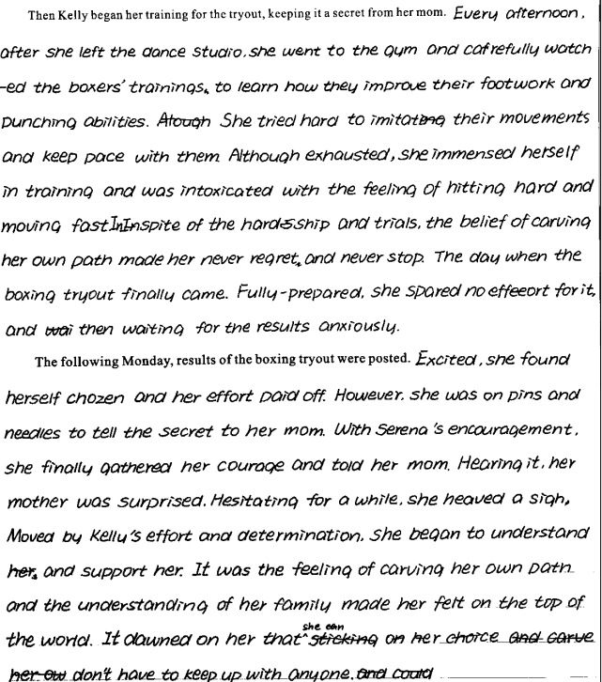
【得分】22 分 【点评】书写美观。能准确完整解读原文信息，情节合理、有序推进、逻辑连贯，与原文融洽度高。故事完整，3 个衔接句子衔接到位。语言表达准确，有细节刻画。句式丰富，灵活运用非谓语、特殊句型等。美中不足是最后的主题升华表述可进一步修改。

Slide 24
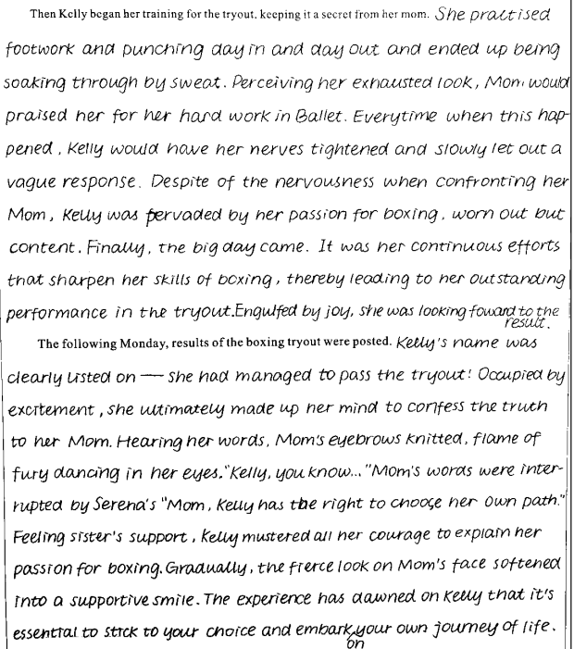
【得分】23-24 【点评】这篇文章内容丰富，情节合理，很好地接续前文的情节。该考生准确把握故事人物的性格特征和故事发展的大方向，根据故事的发展需要合理安排细节，在内容上和故事前文尽可能地协同，结尾合理，对主题的揭示比较自然，能很好地回扣前文提到的 carve her own path，传递正能量和正确的价值观。语言驾驭能力较强，语句通顺连贯，表达方式多样丰富。书写美观，卷面整洁，美中不足就是有略微的超行和涂改。

Slide 25
优秀范文赏析1
Then Kelly began her training, keeping it a secret from her mom. Every day after school, Kelly dashed to the boxing gym, occupying herself with the intense training. Stretching legs, practicing her footwork and improving endurance hand become the bittersweet routine of her life. Even when she was made fun of by boys in the gym, she bit her lip tightly and continued her training. Finally, the tryout came. Extremely nervous though, she stepped into the boxing ring, moved fast and punched hard to the surprise of other candidates. After the tryout, Kelly left the gym confidently, knowing she did her best.
The following Monday, results of the boxing tryout were posted. To her delight, Kelly found her name on the list. Thrilled, she shared the news with Serena, both ready to reveal the secret to their mom. At dinner that day, Kelly gathered her courage and said to her mom, “I’m sorry, mom. I’ve made the boxing team and I’m ready to carve my own path.” At first, a flicker of disbelief and shock crossed her mom’s face, but after a long, heart-to-heart talk, she gave Kelly a bear hug and whispered softly, “I’m so proud of you for being yourself.”

Slide 27
优优秀范文赏析2秀范文赏析1优秀范文赏析1
Then Kelly began her training for the tryout, keeping it a secret from her mom. As usual, she continued attending ballet sessions and used the time to analyze dancers' strength and apply it to her boxing.To avoid suspicion, Kelly told her mom she had joined an after-school study group, which explained her extra time away from home. Every day after school, she would slip into the empty dance studio, practicing her punches and footwork. In the evening, she would watch boxing videos on her phone, studying defensive techniques and striking combinations. Her heart raced each time her mom called or approached, fearful that her secret would be discovered. But Kelly remained steadfast, although mastering boxing was more challenging than she anticipated. Anyhow, there was no regret as she tried her best.

Slide 28
Then Kelly began her training for the tryout, keeping it a secret from her mom.She used her time at ballet to analyze dancers' strength and apply it to her boxing. To avoid suspicion, she told her mom she was joining an after-school study group. Every day after school, Kelly practiced her punches and footwork in an empty dance studio, watched boxing videos in the evenings, and feared being caught by her mom. Despite the challenges, Kelly remained dedicated to mastering boxing.

Slide 29
The following Monday, results of the boxing tryout were posted. , Kelly found her name on the list. Ecstatic, she rushed to share the news with Serena, who swept her sister into her arms, supportive of her determination in pursuing her passion. That evening, Kelly gathered the courage to tell her mom everything. At first, a sense of shock spread over her mom’s face as she learnt the truth. Yet seeing the commitment in Kelly’s eyes, mom gradually softened her expression into a bittersweet smile. “Compared with following the family tradition, your happiness was apparently more important,” mom beamed, stroking her hair. Deeply moved, Kelly hugged her mom tightly, grateful for her tolerance and hopeful for the boxer path she carved.

Slide 30
优秀范文默写
Then Kelly began her training, keeping it a secret from her mom. Every day after school,______________________________________________________________(凯利冲向拳击馆，忙于高强度的训练). Stretching legs, practicing her footwork and improving endurance hand become ______________________(苦乐参半的日常)of her life. Even when she was made fun of by boys in the gym, she _________ _______(咬紧嘴唇)and continued her training. Finally, the tryout came. Extremely nervous though, ______________________________________________________
_____________________(她走进拳击台，动作迅速，用力挥拳，这让其他候选人都很吃惊). After the tryout, Kelly left the gym confidently, knowing she did her best.
The following Monday, results of the boxing tryout were posted. To her delight, Kelly found her name on the list. ________________________________________________________________
______________(激动地，她把这个消息分享给了瑟琳娜，两人都准备向他们的妈妈透露这个秘密). At dinner that day, Kelly __________________(鼓起勇气)and said to her mom, “I’m sorry, mom. I’ve made the boxing team and I’m ready to carve my own path.” At first, _________
________________________________________________________________(她妈妈的脸上掠过一丝怀疑和震惊), but after a long, heart-to-heart talk, she gave Kelly a bear hug and whispered softly, “I’m so proud of you for being yourself.”

